Slide 1

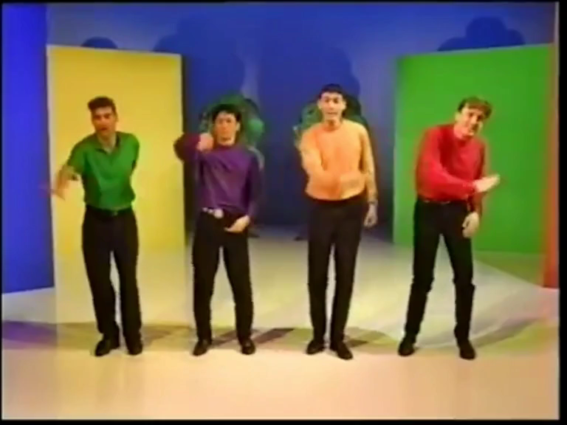
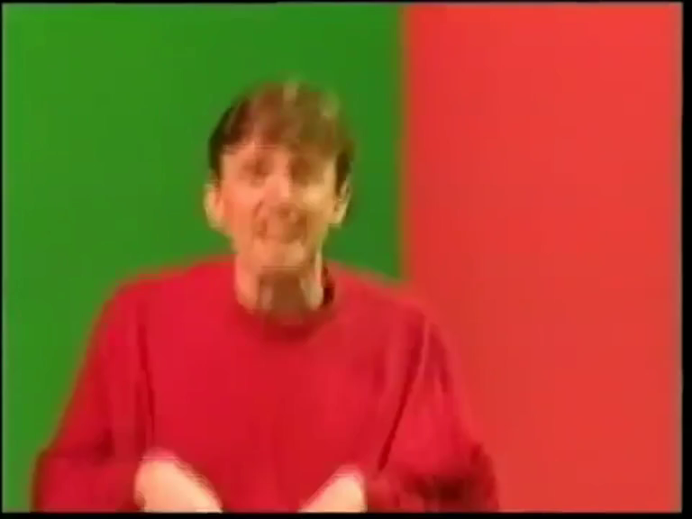
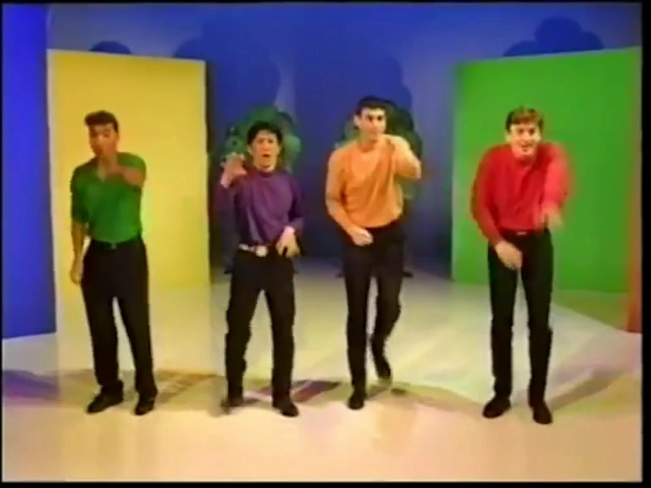
HERE COMES A BEAR
Here Comes A Bear ...
Stomping, stomping
A very scary bear
Stomping, stomping
Claws up in the air
Stomping, stomping
Stomping everywhere
Kangaroo jumps
Boing, boing
Jumps so high
Boing, boing
He almost touches the sky
Boing, boing
Kangaroo jumps so high
Here comes the snake
Hiss, hiss
Slithering along
Hiss, hiss
Body‘s very long
Hiss, hiss
Slippery snake slither along
Wombat crawls
Crawling, crawling
Nose to the ground
Crawling, crawling
He‘s making lots of sound
Crawling, crawling
Crawling everywhere

